Slide 1
Native Grasses, Sedges, & Rushes
Suzanne Hill, Frederick County Master Gardener
The University of Maryland, College of Agriculture and Natural Resources programs are open to all and will not discriminate against anyone because of race, age, sex, color, sexual orientation, physical or mental disability, religion, ancestry, or national origin, marital status, genetic information, or political affiliation, or gender identity and expression.

Slide 2
Mneumonics help us decide: Grass, Sedge, or Rush?
Sedges have edges, rushes are round, grasses are hollow straight to the ground.
Sedges have edges, and rushes are round, but grasses have nodes from their tips to the ground.

Slide 3
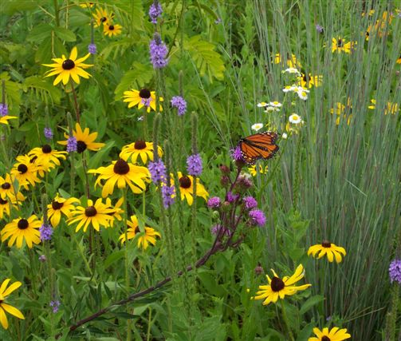
Overview
Why grow them?
Vocabulary
Structure
9 Grasses
3 Cool season
6 Warm season
4 Sedges
1 Rush
References
Notes:
German horticulturist Karl Foerster: “Grasses are the hair of mother earth.” Bill Cullina: “A garden without grasses is like a face without eyebrows.”

Slide 4
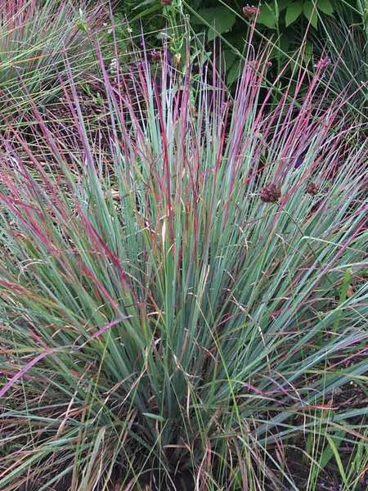
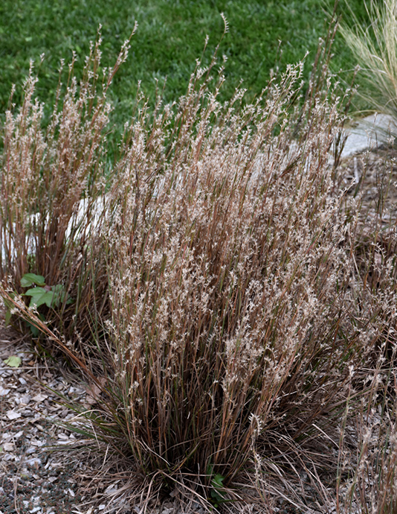
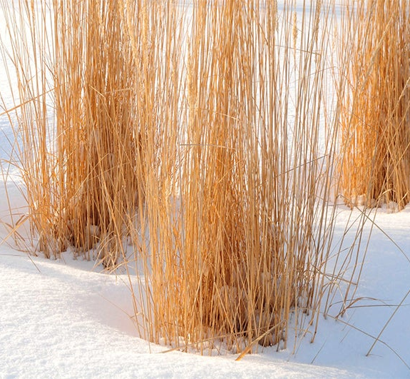
Why grow native grasses, sedges,& rushes?
Year-round beauty!
Adapted to MD climate/ soils
Easier to maintain
No need to fertilize
Once established, need no
additional water
No staking or deadheading
Habitat for wildlife
Most are deer resistant
Notes:
Little bluestem ‘standing ovation’

Slide 5
Compare root depths of lawn grass and native grasses! Deep roots stabilize soil and mine minerals deep within the soil.
wisconsinpollinators.com

Slide 6
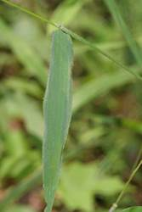
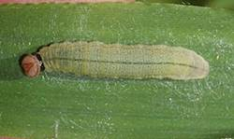
Benefits to Wildlife: Caterpillar host plants
Photos: Rita Venable
Caterpillar hides
inside grass leaves
Salt and Pepper skipper
Notes:
The caterpillars construct a retreat by rolling a grass blade (or two) into a tube which is held together with silk threads and suspended from a grass blade. Later, they chew through the strands holding the nest to the grass blade and drop to the ground. It seals itself in the nest where it overwinters until the following spring or summer before pupating.

Slide 7
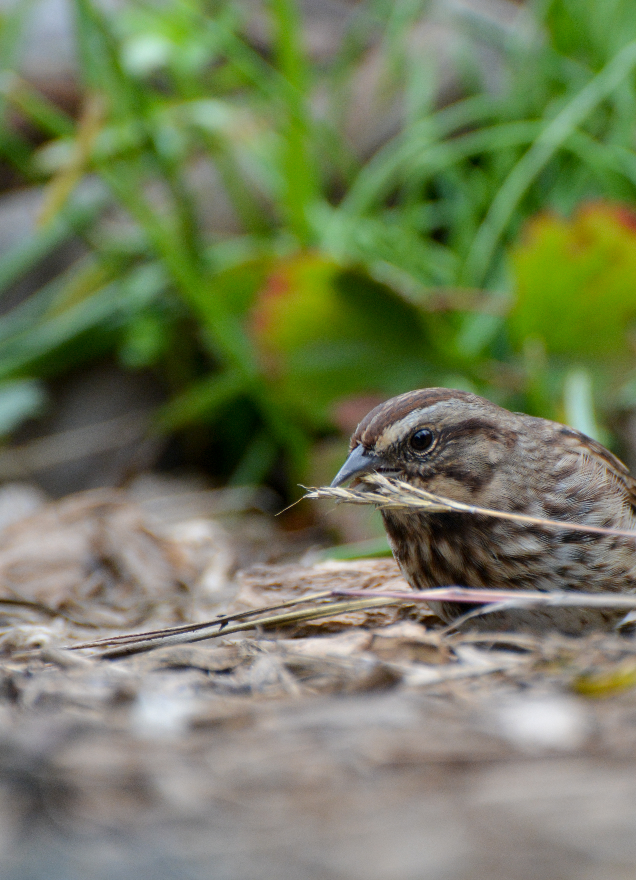
Don’t forget birds and their young!
Janet Allen

Slide 8
Graminoids are wind pollinated. Some insects do use grass pollen, but its nutrient value has not been well studied.
Big bluestem’s bright yellow anthers

Slide 9
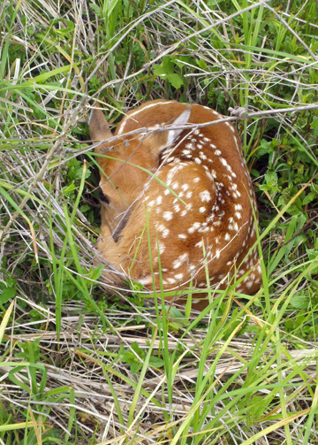
Benefits to wildlife
SHELTER
Carolyn Byer
Notes:
Eastern meadowlark nest

Slide 10
Winter shelter: many creatures, including overwintering queen bumblebees! Non-lodging cultivars less useful.

Slide 11
Native American basket-Kumeyaay (CA) Primary coils: deergrass culms Secondary coils: native rush stems

Slide 12
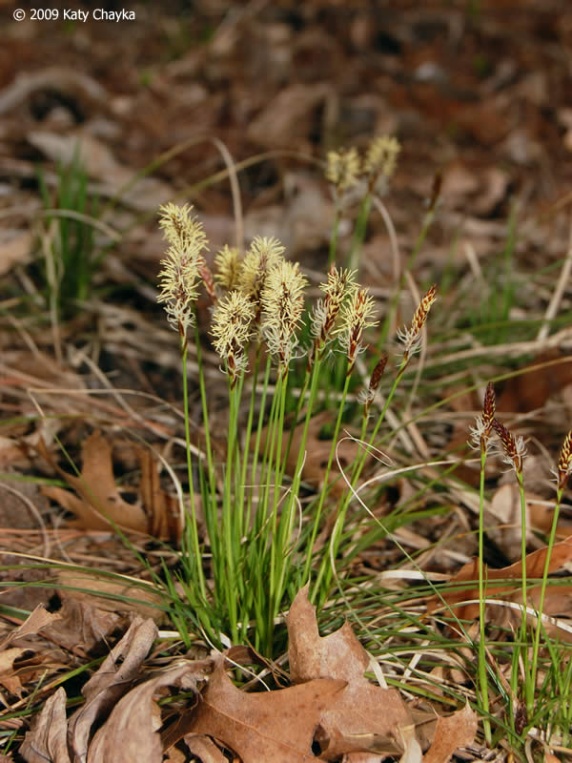
Vocabulary for Graminoids Grass-like plants Monocots (1 seed leaf)
Gram-(L), grass
Po-(G), grass
Poaceae-grasses
Cyper-(G), sedge
Cyperaceae-sedges
Juncus-(L), rush or reed
Juncaceae-rushes
Nod-(L), swelling
Pennsylvania sedge
Katy Chayka

Slide 13
3 Types of Grass Inflorescences
Raceme: spikelets on short stalks coming off main culm (stem)
Panicle: spikelets spaced along branches
Spike: spikelets attach directly to main culm
Notes:
In a raceme, spikelets are borne on short stalks, called pedicels, coming off a main culm. A spike has its spikelets attached directly to the main culm. The panicle has its spikelets spaced along spreading or compressed branches.

Slide 14
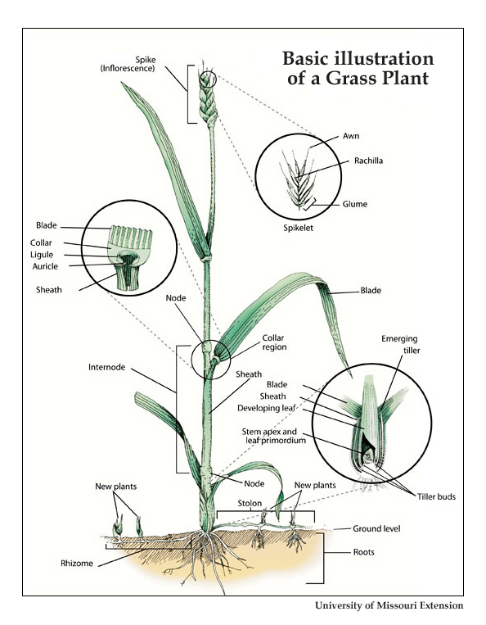
Grasses: Leaves are 2-ranked (leaves come out on the two opposite sides of the stem)
Awn-(Old English), tool for piercing
Culm-(L), a stalk
Glume-(L), husk, hull
Lemma-(G), a husk, peel, or sheath
Palea-(L), chaff/straw
Pedicel-(L), little foot
Notes:
Awl-old English, tool for piercing leather, etc. 2-ranked-not the same as opposite leave arrangement. Pale-Pail lee ah. Rack’ il la

Slide 15
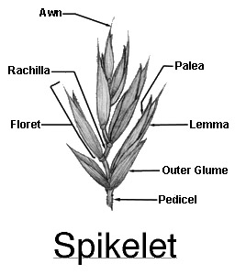
Grass Anatomy
Hollow, rounded stems
Jointed stems (nodes)
Spikelet inflorescence
1 to many florets
Glumes-bract at base
2 bracts at base of floret

Slide 16
Grass Inflorescences Usually perfect (both male and female parts) Floret: wrapped in 2 scales or ‘bracts’ (lemma and palea) One seed (grain) per flower
Note: lemma may have long spike (‘awn’) at the end.

Slide 17
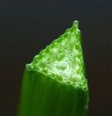
Sedges: “Sedges have edges.”
Stems:
Solid
No nodes or joints
Triangular in cross-section
Tough and wiry
Leaves
Flat
3-ranked, come from 3 different sides
Distinct midrib
Leaf sheath closed around stem
Notes:
Triangular, especially at base. 3-ranked means leaves come from 3 different sides of stem

Slide 18
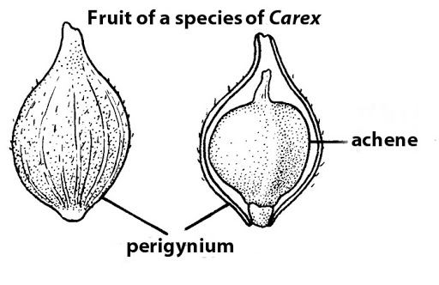
Sedge Inflorescences
Perfect (Carex spp. flowers are unisexual)
Bottle-shaped bract around female flower: perigynium
Florets grouped into spikes or spikelets
Fruit: achene
Carex
Notes:
Achene: simple dry fruit that does not split at maturity. Examples: aster family, a dandelion seed

Slide 19
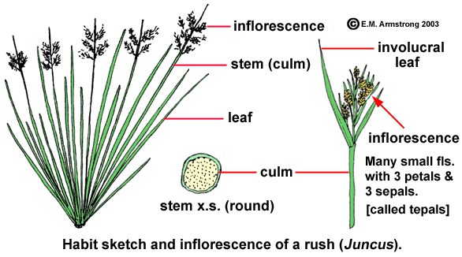
“Rushes are round.”
Solid, rounded, unjointed stems (culms)
Leaves
Simple
Mostly basal
3 ranked
www2.palomar.edu

Slide 20
Rush Inflorescences
Floral parts:
6 tepals
Whorls of stamens
3-lobed stigma
Ovary with 3 carpels
Lateral or terminal flowers
Panicles or heads
Fruit: a capsule with 3 or more seeds
Notes:
Capsule: A dry dehiscent fruit developed from several carpels. Dehiscent-splits open at maturity.

Slide 21
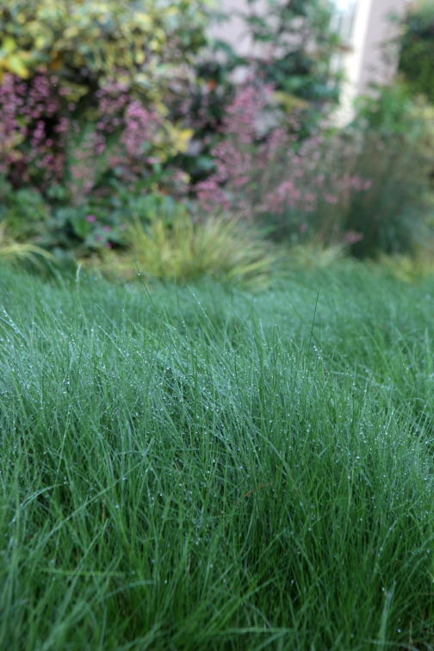
Cool Season Grasses
Flower and grow most actively in cool, moist weather (spring and fall)
Evergreen to semi-evergreen in winter
May need supplemental watering during drought to avoid dormancy
Examples:
Most lawn grasses
Festuca rubra, native mountain red fescue is used as turf grass in part shade but does not tolerate high traffic

Slide 22
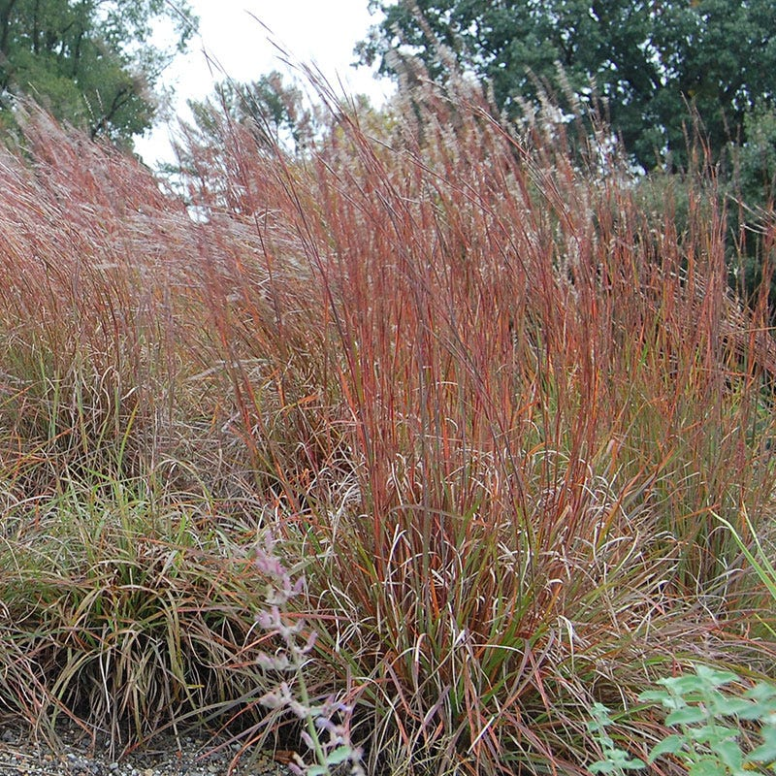
Warm Season Grasses
Flower and grow most actively in warm, dry weather (summer and early fall)
Emerge in late spring to early summer
Thrive in high temps and low moisture
Cut back in early spring (8-20” for native bees)
Example: little bluestem
(Schizachyrium scoparium)

Slide 23
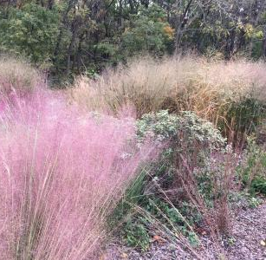
Many ways to use native graminoids
Specimen plant in garden/ container
En masse or with other native plants
Groundcover
Contrast with evergreens or solid surfaces such as walls or paths
Repeat plantings to create pattern
Create prairie or meadow
“Hellstrips,” xeriscape, rock garden
Raingardens
Erosion control on slopes

Slide 24
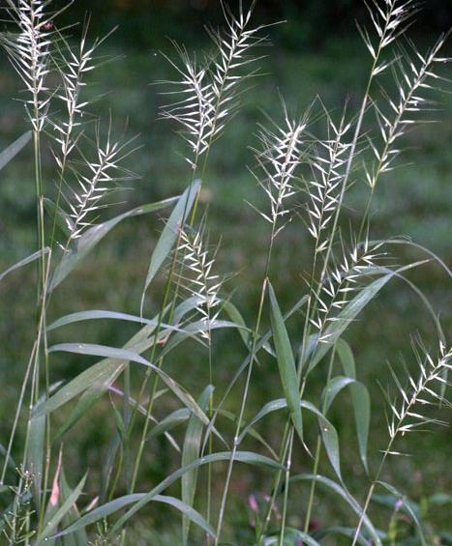
Eastern Bottlebrush Grass Elymus hystrix (Greek hystrix= hedgehog)
Cool season grass, native to MD woodlands and floodplains
Clumping, open habit
Evergreen foliage: ½” wide, 12” long
Height: 2-5’ Spread: 1-2’
Seed heads develop early summer
Long, stiff bristles (awns)
Waxy coat on seeds/stem-show best against dark background
Notes:
Evergreen in coldest winters. White waxy coating Elymus-Greek, a kind of grass. EL e muss

Slide 25
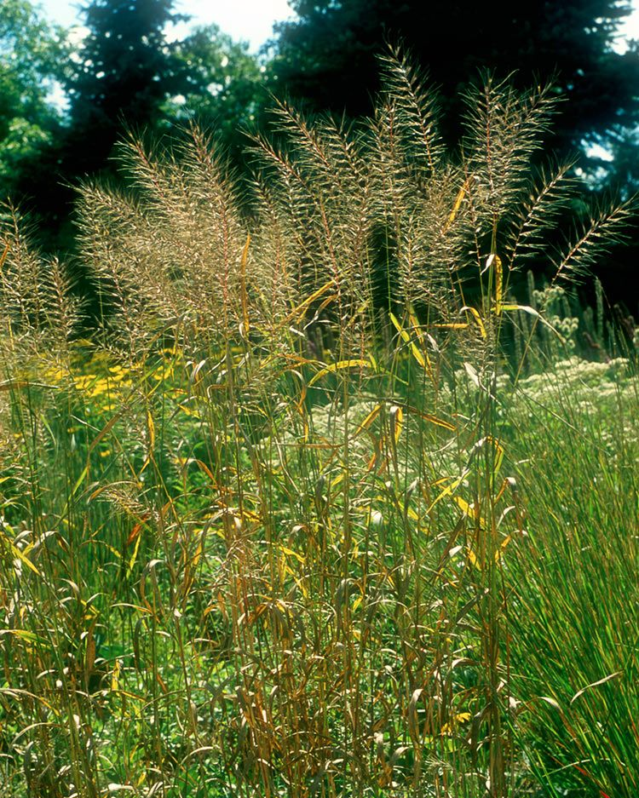
Growing conditions
Part sun/part shade
Moist-average, well drained soil
Tolerates salt, black walnut, air pollution, drought
No serious pests or diseases
Deer rarely damage
Prefers calcium rich soil-grow near concrete or add seashells!
Notes:
Deadhead seeds to prevent excess seedlings. Cut brown stems to showcase evergreen foliage in winter.

Slide 26
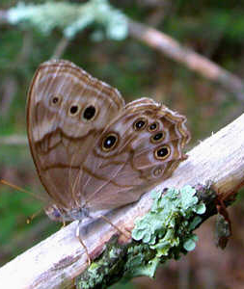
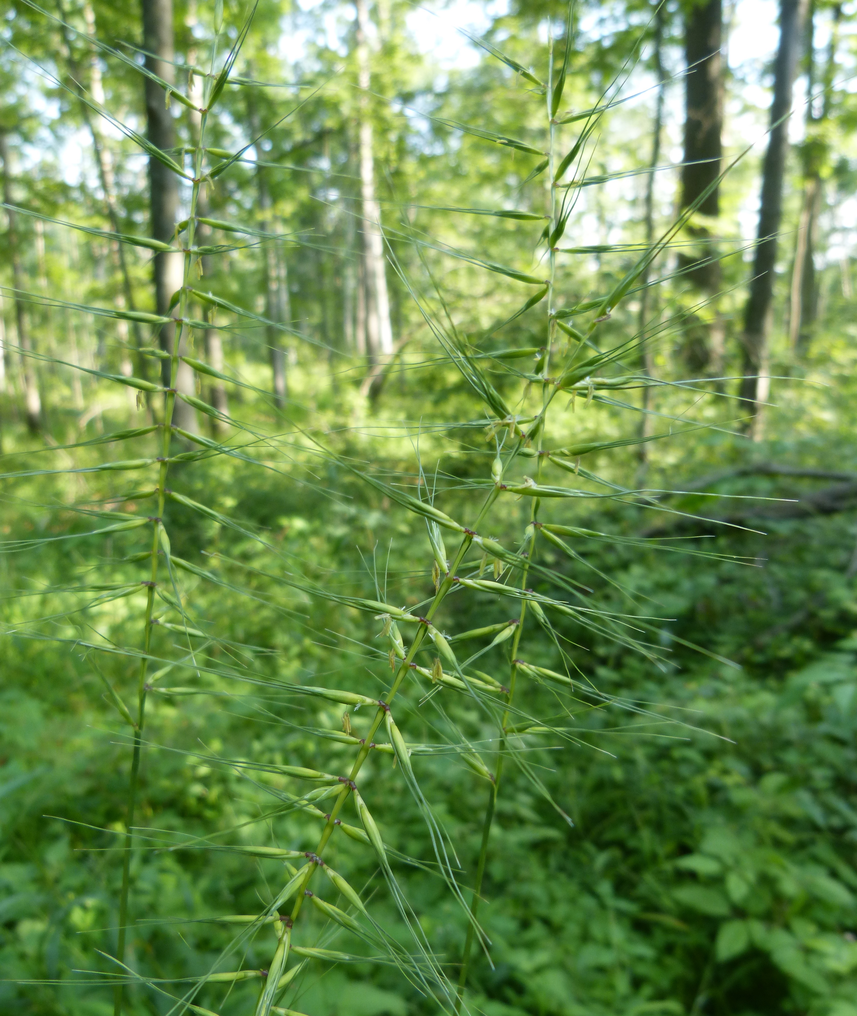
Bottlebrush Grass: Maintenance and Benefits
Maintenance
Seeds shatter Aug.-Sept.
Self-seeds, form colonies
Cut stems in fall, foliage late winter
Landscape-most shade tolerant native grass
Evergreen foliage in winter
Lightly shaded woodland gardens, forest edge
Dry shade
Erosion control
Host plant: many Lepidoptera, including Northern pearly eye
Seeds for birds

Slide 27
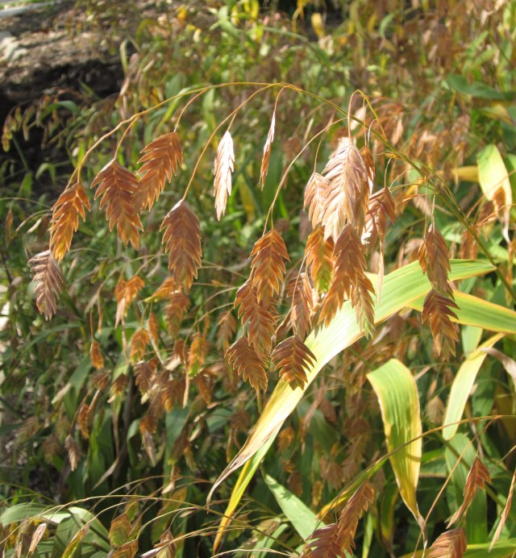
Cool season Sea oats
Elaine Mills

Slide 28
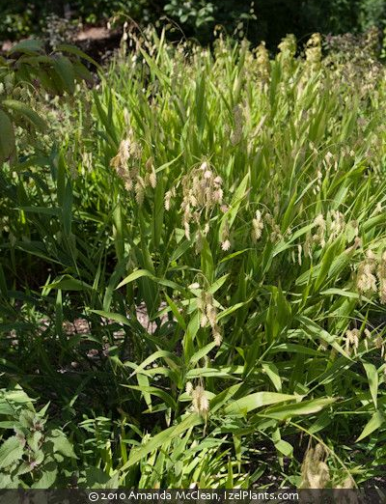
Indian, Wood Oats, or River Oats Beautiful, tall, upright, clumping, woodland grass
Notes:
Other names include Indian oats, wood oats, river oats

Slide 29
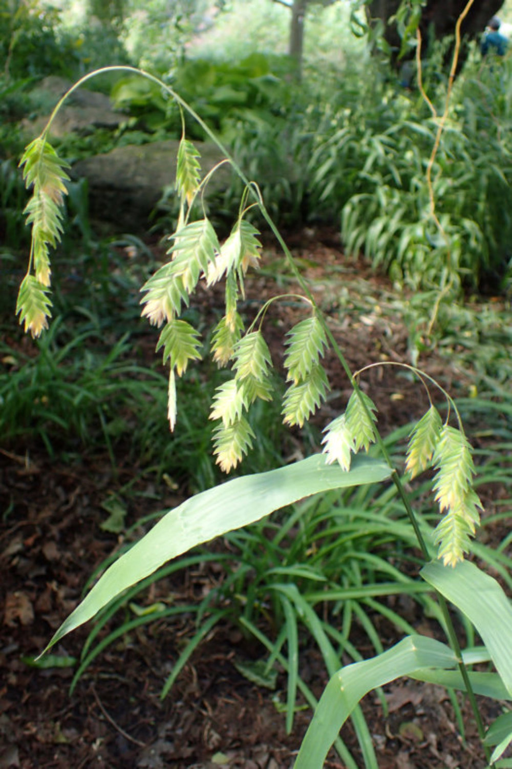
Northern (Inland) Sea Oats Chasmanthium latifolium
Light Requirements- sun, part-sun, part-shade
Soil Moisture- dry, moist, wet
Soil Description- average, well-drained
Height 2’-5’ Spread 2-3’
Bloom Time- June-September
Bloom Color-green, dries to tan for fall interest
Use in groups, borders, rain garden, slopes, erosion

Slide 30
Sea oats
More shade tolerant than most grasses
No serious pests, deer rarely damage
Readily self seeds: can form large colonies and reduce erosion along stream banks
Cut back: in late winter or early spring
Dried seed stalks: floral arrangements
Host plant: common roadside skipper
Tolerates: salt, black walnuts
Jenni Kayne

Slide 31
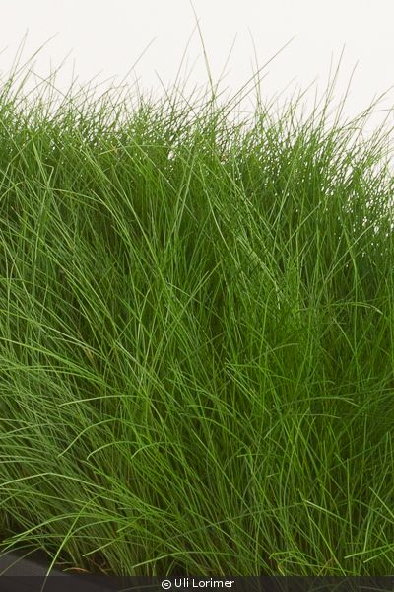
Wavy Hair Grass (Deschampsia flexuosa)
Evergreen
Native to forest clearings
Mounding, clumping, arching habit
Height: 2-3’ Spread: 1-2’
Dense tufts of fine textured foliage
Part sun, part shade to shade
Soil: dry-moist (tolerates dry shade)

Slide 32
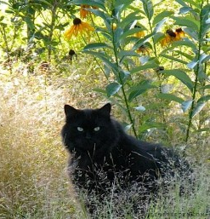
Attributes and Uses of Wavy Hair Grass
Bloom: green, May-July
Attractive dried silvery seed heads glow in sunlight (fall/winter interest)
Uses:
Rock garden
Group in shade garden with white wood aster, Christmas fern, alumroot
Wildlife: seeds for birds, basal foliage for shelter
The Gardeners’ Eden
Notes:
Used with permission. Woo the cat just passed at 20.5 years.

Slide 33
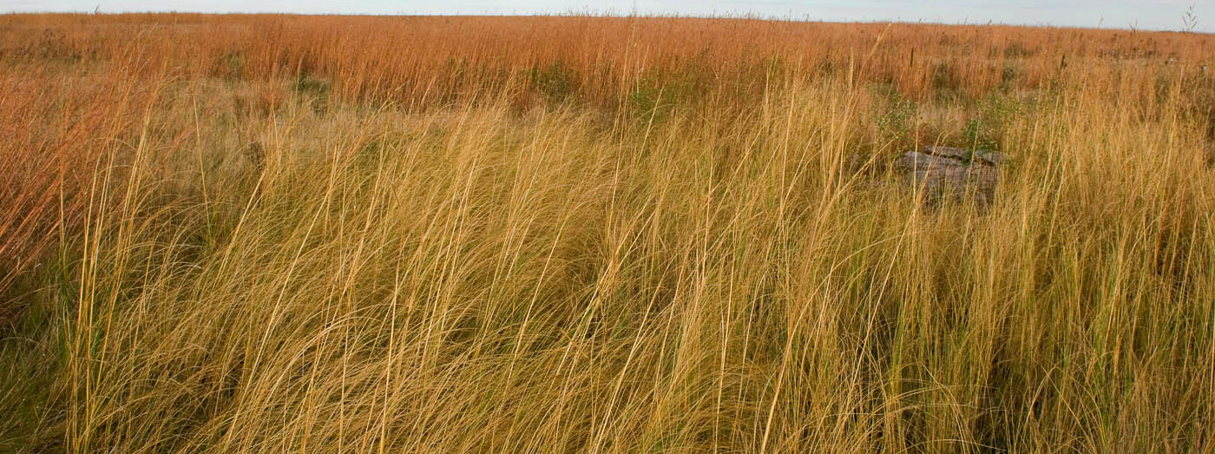
Warm Season Grasses
Indian Grass
Little Bluestem
Switchgrass
Purpletop Grass
Purple Love Grass
Prairie Dropseed

Slide 34
Indian Grass: Sorghastrum nutans, native to Maryland M, P, C regions
Nan Hampton-LBJWC

Slide 35
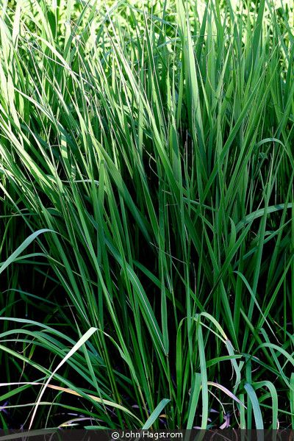
Indian Grass
Upright, clumping grass
Light: full sun is best
Soil:
Average, poor, sand, gravel/rock
Dry to moist, well-drained
Flops (lodges): soil too moist or rich, too much shade
Height: 3-7’ Spread: 3’
Leaves: ½” wide, 2’ long, blue-green to tan in fall

Slide 36
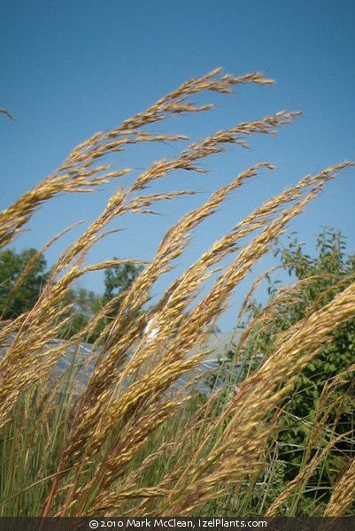
Indian Grass
Bloom Time: Aug. – Oct.
Bloom Color- light brown/coppery panicles with silver sheen in winter
Easily grown from seed
Cut back in early spring
No serious pests or diseases
Deer may damage
Tolerates:
air pollution, black walnut
drought: roots may grow 9’ deep

Slide 37
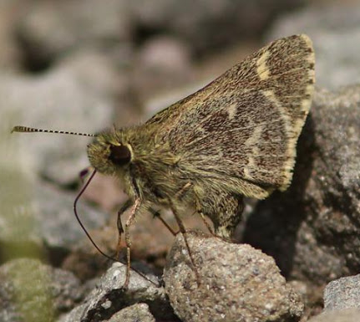
Indian Grass: Beneficial and Useful
Wildlife
Seeds: songbirds
Nesting/shelter: birds, small mammals, native bees
Larval host plant: salt and pepper skipper
Uses
Specimen, vertical accent in border
Erosion control, slopes
Massed for prairie or meadow gardens
Combine with native wildflowers

Slide 38
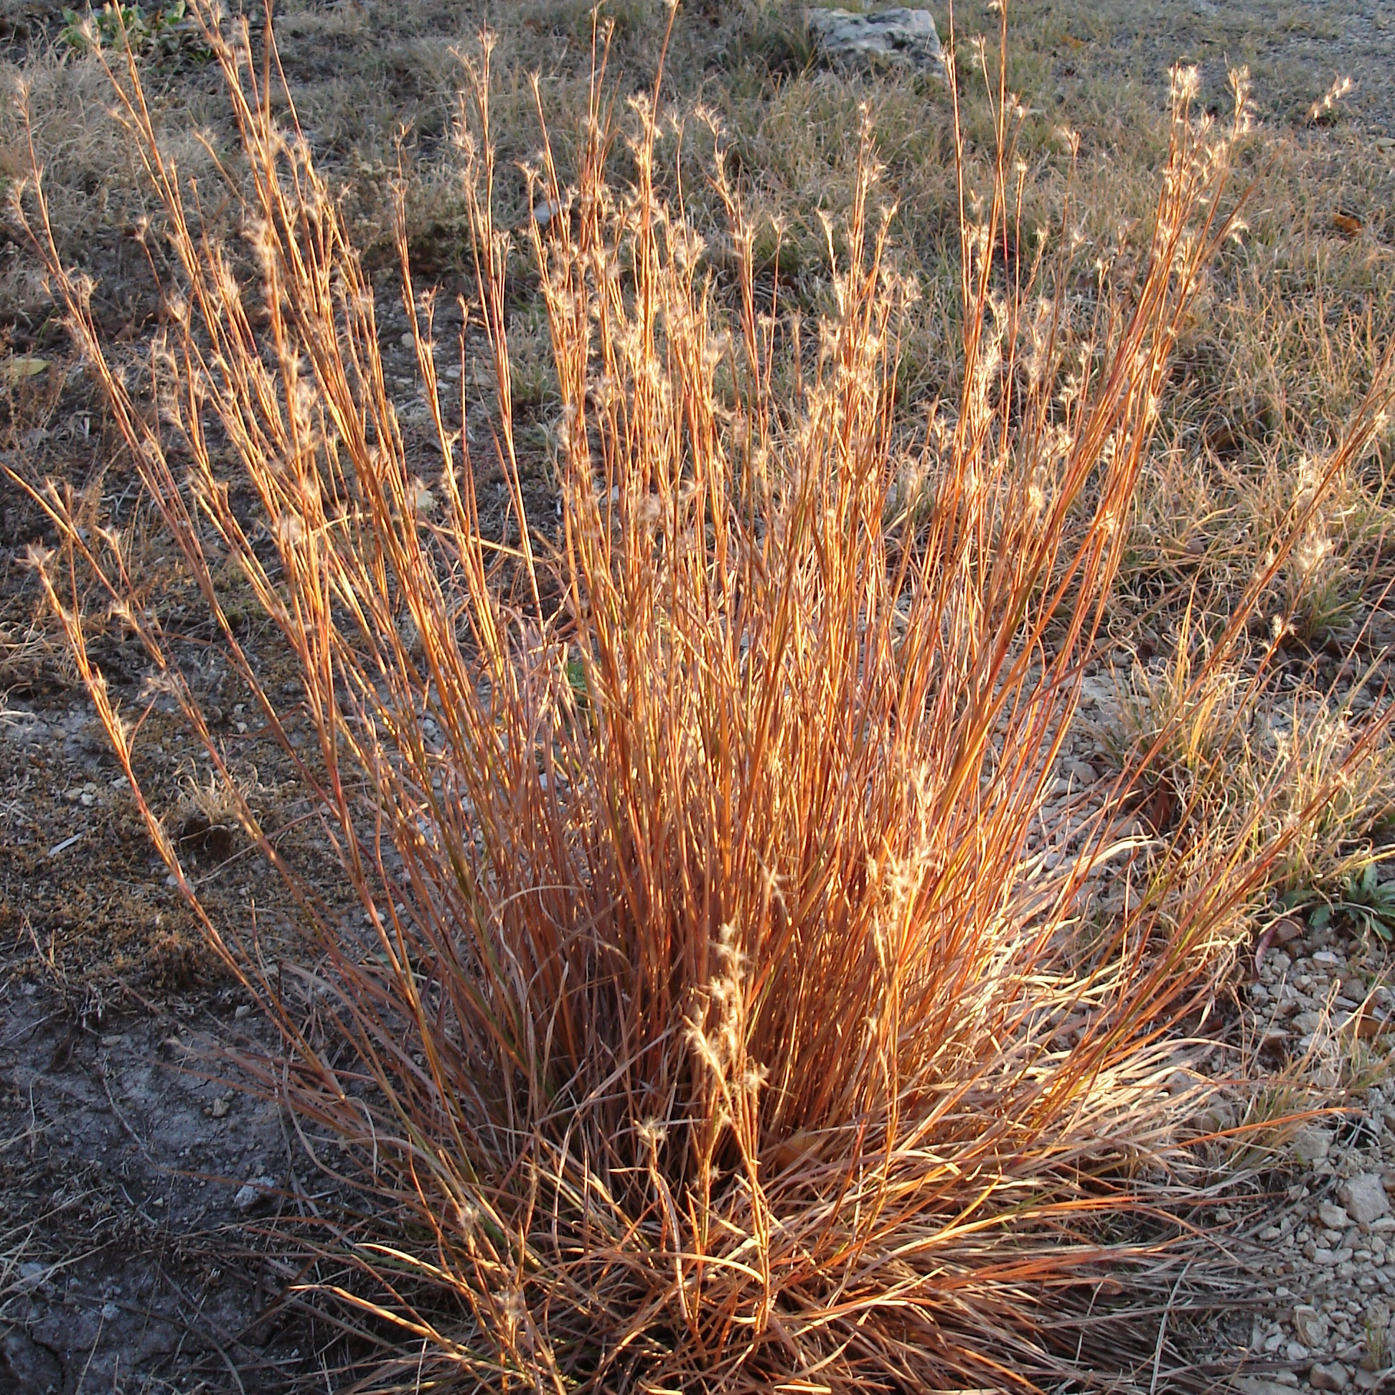
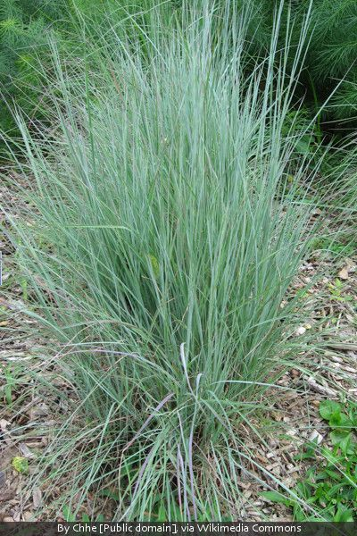
Little Bluestem Schizachyrium scoparium
Upright, clumping
Native to open woods, wood edges, prairies
Roots: fibrous, 5’ deep
Three season interest
Valuable forage grass

Slide 39
Little Bluestem
Light: full sun is best
Deep roots (7’)
Soil
Dry to moist (seasonal drought OK)
Well-drained
Average to poor, acid, alkaline
Flops: soil too wet or rich, in shade
Height: 2'-4’ Spread: 2’
Foliage: slender, glaucous gray-green
to blue, copper-red-tan in fall/winter

Slide 40
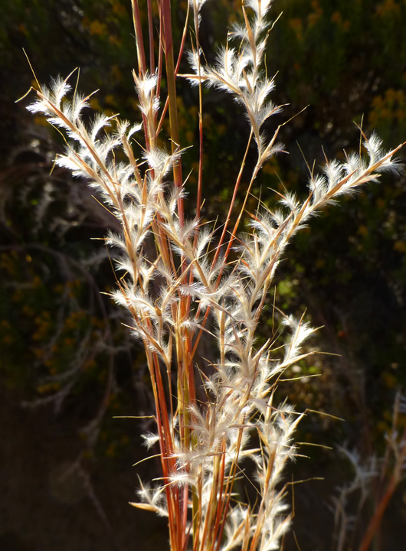
Little Bluestem
Bloom Time: July- October
Blooms:
3” long racemes of spikelets
Fluffy silvery-white seed heads
Readily self-seeds, easily grown from seed
Stems: wiry and persist in winter
Cut back in late winter or early spring
Max Licher

Slide 41
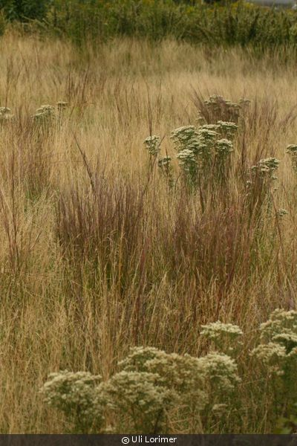
Attributes and Uses
Tolerates: air pollution, fire, black walnut
Intolerant of flooding (not for rain gardens)
Rarely bothered by deer; no serious pests or diseases
Wildlife
Seeds/nests: birds, small animals
Host plant to many lepidoptera
Uses: specimen, container, in mass along borders, in meadow or prairie gardens, erosion, slopes

Slide 42
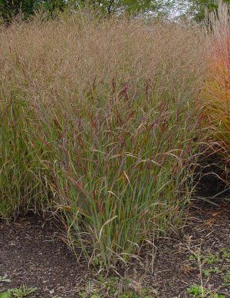
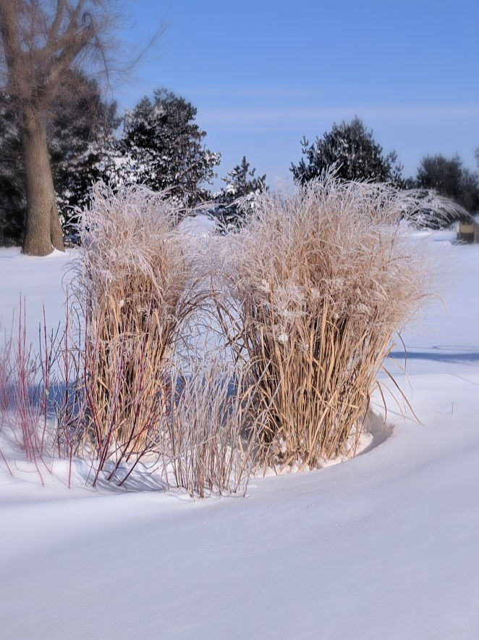
Switchgrass: Panicum virgatum
Native to tall grass prairie, open woods
Stiff, clumping
Narrow, vase-shaped
Open airy seed heads
3 season interest
Notes:
Tall grass prairie 4: big and little bluestem, Indian grass. Switchgrass. Most popular native landscape grass!!

Slide 43
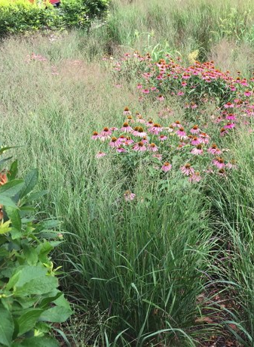
Switchgrass
Light: sun, part-sun (best in full)
Soil Moisture: dry, moist, wet,
Soil Description: average to poor, loam, clay, sand, rocky
Height: 3’-6,’ 8’ in bloom
Width: 2-5’
Leaves:
2’ long, ½” wide, arching
green to russet, yellowish tan in winter

Slide 44
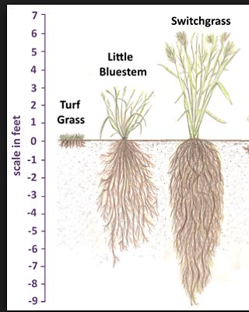
Switchgrass roots
Crown of congested rhizomes
Fibrous roots: 8-10’ deep
Stabilize soil
Control erosion
Mine soil for minerals
Mgnv.org

Slide 45
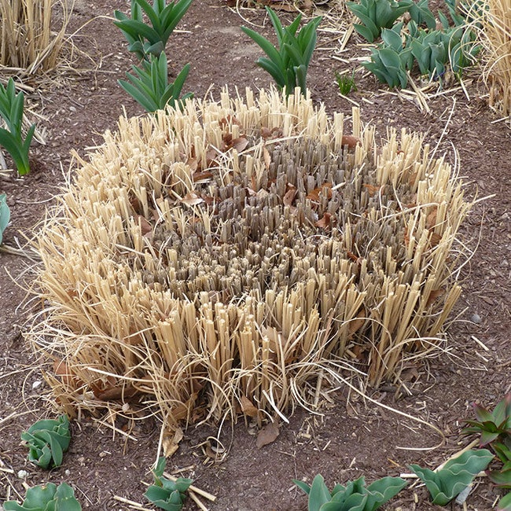
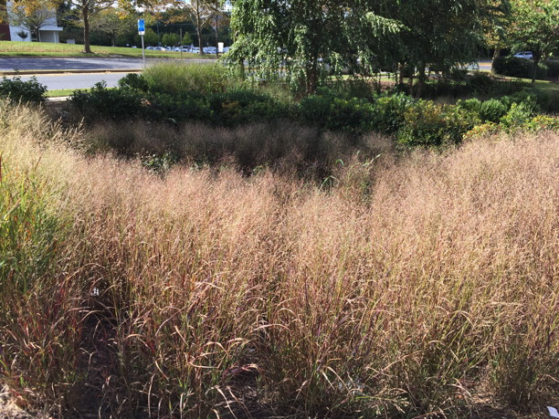
Elaine L. Mills
Garden tip: Emerging grass
will hide fading spring bulb
foliage!
Bloom Time: July-September
Bloom Color: pink tinged
Cut back in spring (leave 8-20” for native bees)

Slide 46
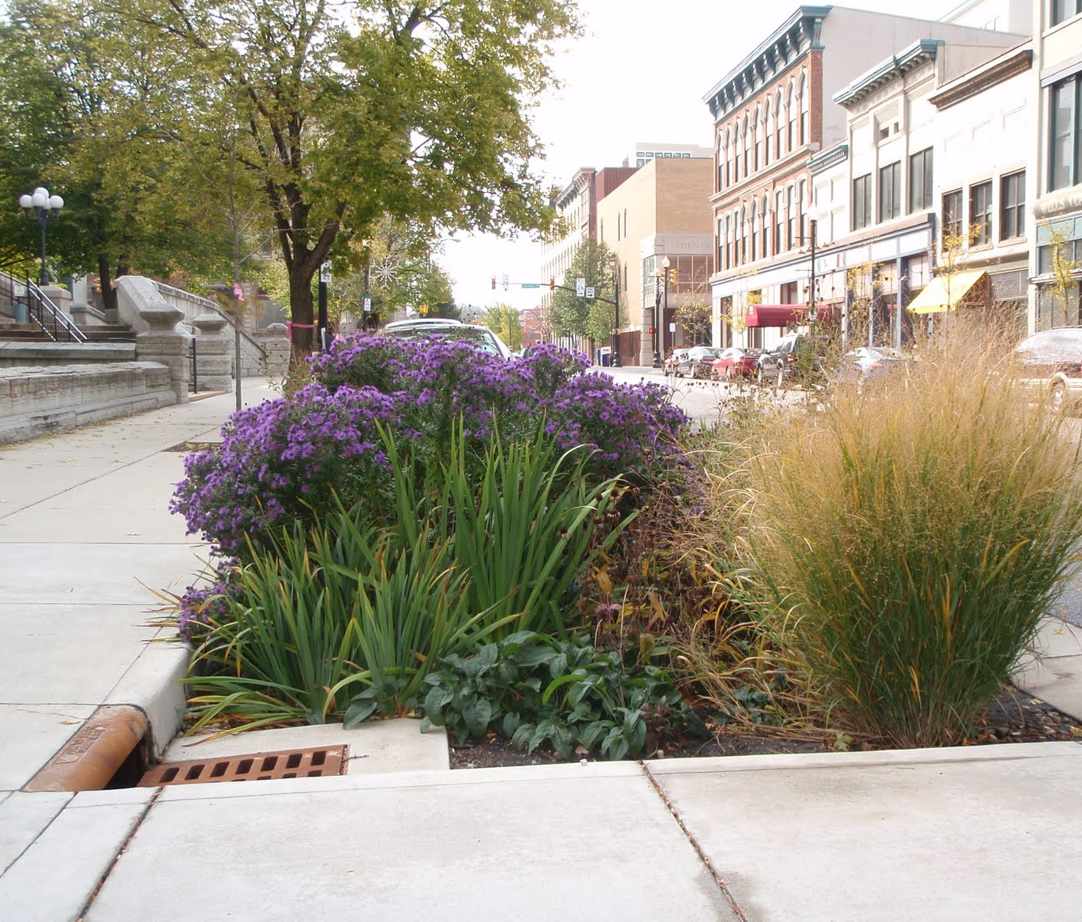
Switchgrass: Attributes and uses
Forms colonies: spreads by rhizomes and self-seeding
Tolerates drought, salt, occasional flooding (rain garden)
No serious pests or diseases
Deer rarely damage
Wildlife: seeds/shelter, host plant
Uses: accent plant, mass planting, screen, borders, meadows, erosion control, slopes
Notes:
Larval host for skippers and satyr butterflies.

Slide 47
Purpletop grass, native to woodland openings
Purpletop can be appreciated at 55 mph!
LARRY WEANER LANDSCAPE DESIGN

Slide 48
Purpletop Grass: Tridens flavus
Light: sun, part-sun
Soil: dry, moist, well-drained
Soil: average-poor, loam, clay, sand, rocky
Upright clumping grass
Basal leaves: green, 16” long, 5/8” wide
Height: 4' Spread: 3’
Bloom
Aug.- Oct.
Airy, reddish purple panicles
Notes:
Tridens refers to a small group of grasses that have 3 lines of fine hairs along the lower halves of their lemmas.

Slide 49
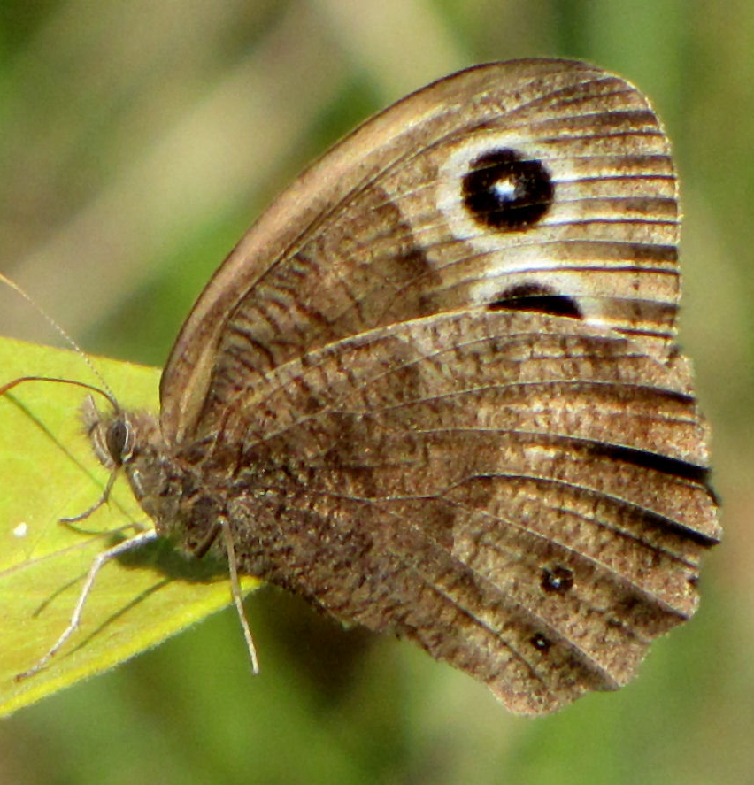
Purpletop: Attributes and Uses
Tolerates drought, poor soil, compaction, salt, air pollution
Mowing: 1-2x/ year
Deer rarely browse
Oily seeds (‘grease grass’ ) eaten by birds and small mammals
Host: many lepidoptera
Propagate: division or seed in fall
Use in mass: roadsides, meadows
Common wood nymph
D. Gordon E. Robertson

Slide 50
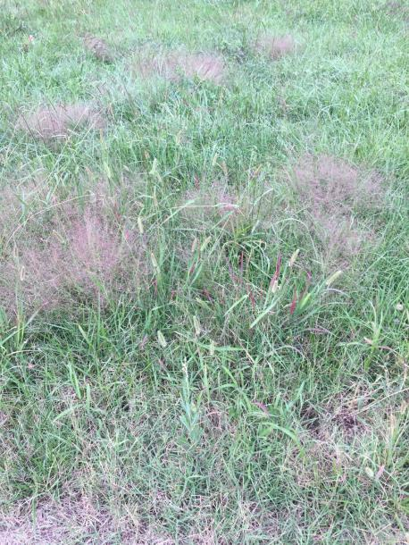
Purple Lovegrass Eragrostis spectabilis Native prairie grass
Light: sun
Soil (sandy/gravel)
Dry-medium, well-drained
Average-infertile
Clumping, dense tufts
Height: 1-2’ Spread: 2-3’
Blooms rise above foliage
July-October
Open, airy
Green> reddish purple > tan in winter
Eros
Freepik.com
Elaine Mills

Slide 51
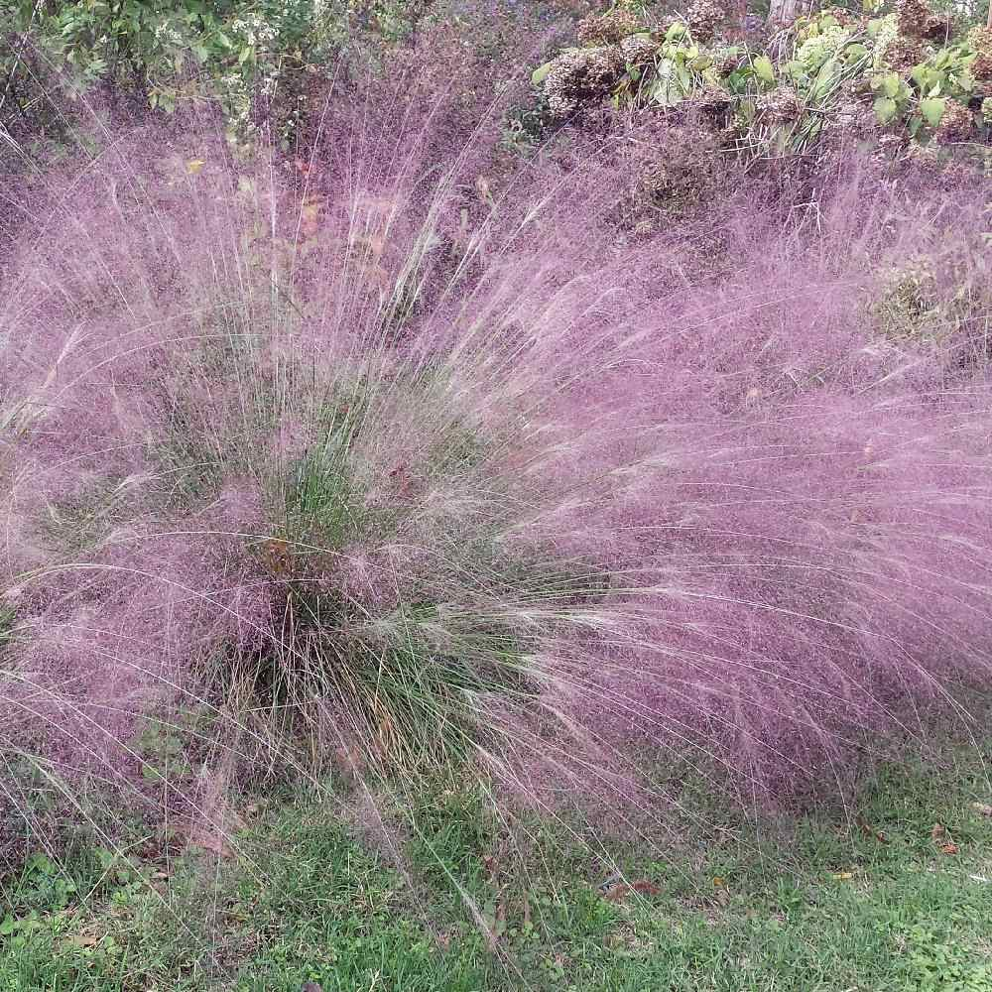
Purple lovegrass
Spread: self-seeds, slowly by rhizomes
Spring
Cut back
Propagate by division
Replace: non-native fountain grass!
Tolerates: drought, black walnut, air pollution, poor soils, road salt
No serious pests or diseases
Deer rarely damage

Slide 52
Uses: borders, path edging, meadows, “hell-strips,” dried flower arrangements
ArcheWild

Slide 53
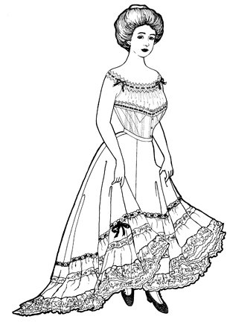
Tumblegrass, Petticoat Climber
After flowering, inflorescence breaks off and floats around like tumbleweed!

Slide 54
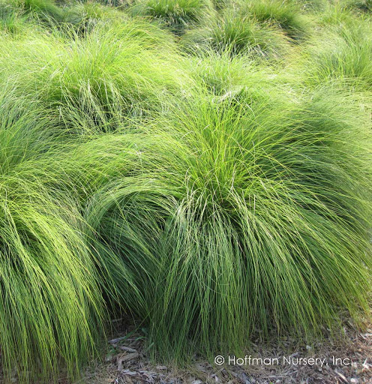
Prairie Dropseed: Sporobolus heterolepsis
Height: 2-3’ Spread: 2-3’
Sun: full
Soil: dry to medium, sandy, well-drained
Roots: dense and fibrous
Clumping, slow to establish
Leaves: hair-like, medium green

Slide 55
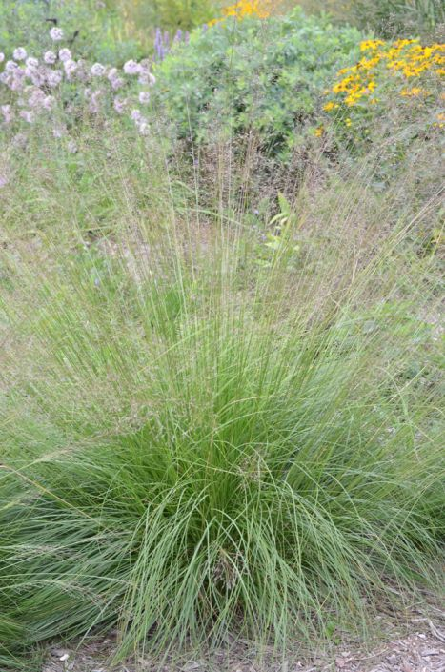
Prairie dropseed
Bloom:
August-October
Soft arching , open panicles
Rise about foliage
Pinkish tan flowers
Fragrant-buttered popcorn!
Seeds
Drop in fall
Relished by birds
Rare native in MD Piedmont

Slide 56
Lovely fall color fades to light bronze in winter.

Slide 57
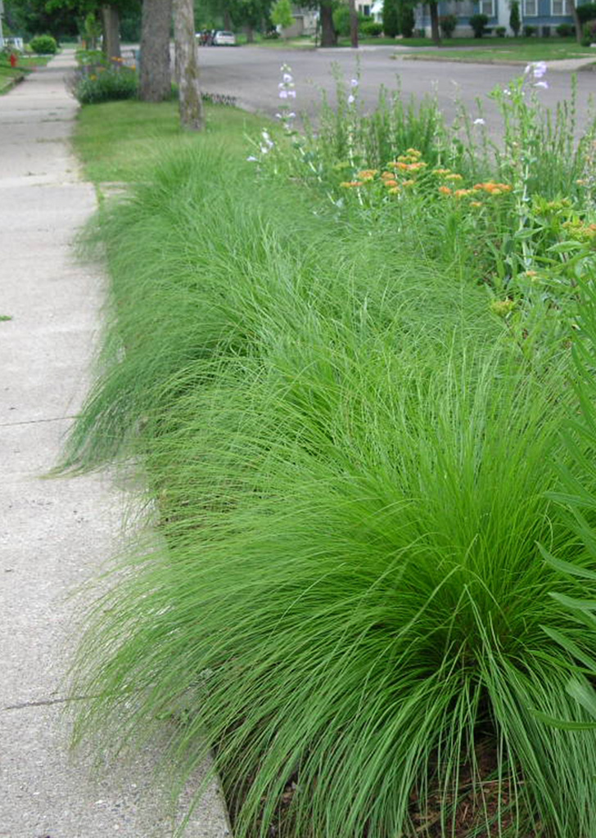
Dropseed attributes and uses:
Tolerant of deer, drought, shallow rocky soil, black walnut, air pollution
No disease or pest problems
Uses: ground cover for hot and dry areas, erosion control, meadows, borders
Wildlife:
Seeds for birds
Nesting material
Shelter for native bees

Slide 58
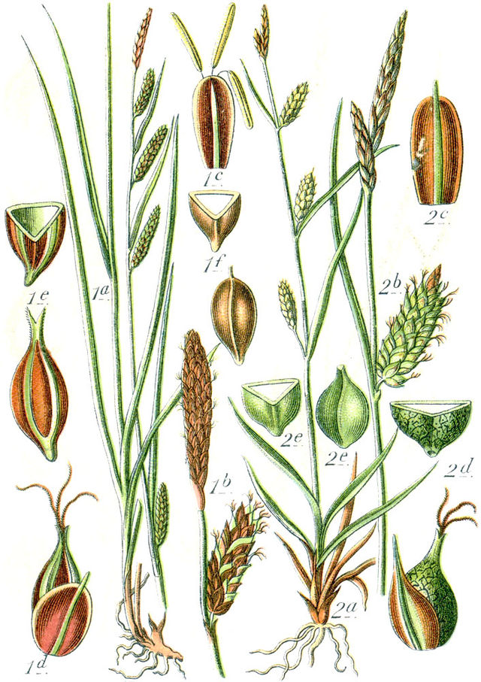
Cyperaceae: Sedges
Carex pensylvanica
Carex plantaginea
Carex platyphylla
Carex grayi
Wikiwand.com

Slide 59
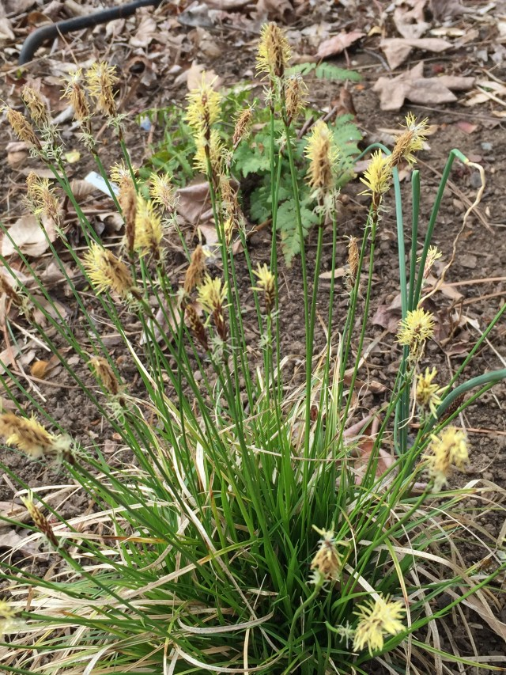
Carex pensylvanica Pennsylvania sedge
Ht: 6-12”
Fine green foliage
Blooms: April-June
Full sun to full shade
Dry to moist, well drained soils
Habitat: rocky woods, open sandy areas
Deer resistant
Lawn substitute but not walkable-use pavers

Slide 60
Spreading by rhizomes PA sedge makes great ground cover under large shade trees. Grows easily from seed.

Slide 61
Carex pennsylvanica and Sedum ternatum under an oak

Slide 62
Carex plantaginea “Plantain leaved” or “Seersucker” sedge Grows quickly into nice clumps, slowly spreads by short rhizomes Native to mountain region
Wasowski, Sally
Notes:
Texture and form in spades with its wide straps of light catching puckered foliage and a tight but arching clumping habit. Low, bold-textured and weed suppressing mass. It plays well with others in the garden.

Slide 63
Ht: 6-12” Spread: 1-2’ Broad (1”) evergreen leaves Blooms: March Tolerates rocky soil, alkaline soil, and dry shade Larval host plant Birds eat seeds
< anthers
< stigmas
Keith Board
Notes:
Native to Montgomery and Garrett Counties. Maroon and green striped culms (stems). Short rhizomes. Tolerates dry shade once established. Rarely bothered by deer. No serious pests or diseases. Hardiness USDA zones 5-8

Slide 64
Moist, well drained, rich soil Part to full shade Cut back in late winter, before new growth Propagate: divide clumps in spring Uses: ground cover, erosion control, edger, specimen, en masse with other shade plants Replaces: Liriope, Hosta, mondo grass
PLAYS WELL WITH OTHERS IN THE GARDEN!
Notes:
In Woodland shade garden USE as textural contrast to broader-leaved natives such as Trillium, Uvularia-merrybells, or fine, airy ferns. A favorite with William Cullina

Slide 65
Seersucker sedge en masse
Photo: Sean James

Slide 66
Carex platyphylla Silver or broad-leaved sedge
Height: 1’
Leaves: 1” wide, 1’ long
Color: shiny, green to powder blue
Clumping habit
Soil: moist to dry, well-drained
Native to upland forests, M, P regions

Slide 67
Shade- part shade Tolerates drought, alkaline soil Use: edger, groundcover in shade Replace: Hosta, Liriope Deer resistant Trim evergreen leaves in late winter
Charles Gleaves
Notes:
Another favorite of Bill Cullina. Native to rocky slopes and streambanks in rich deciduous woodlands. New leaves and flower stalks in early spring. Divide in spring. Tolerates alkaline soil, poorly draining soil. Haircut in late winter Uses same as C. plantaginea.

Slide 68
Silver sedge
Bloom: purple, June
Companion plants: columbine, crested iris, Heuchera
Divide in spring
Seeds: song and game birds
Host plant: 35 species of lepidoptera
♂
♀
Stephen Bloodworth

Slide 69
Silver sedge Photo: Betty Truax

Slide 70
Carex grayi

Slide 71
Gray’s Sedge
Sun to part shade
Ht. 2-3’ Spread: 1-2’
Clumping form
Grass like foliage: semi-evergreen
Soil: wet to moist, tolerates temporary flooding

Slide 72
Carex grayi
Native: low-lying areas near rivers, bottomland forests (P,C regions)
Tolerates: part shade, deer, drought, wet soil
Propagate: seed in fall, division in spring
Wildlife:
Seeds for game and songbirds
Lepidoptera
Muskrats

Slide 73
Uses: specimen, border, containers, raingardens, bioswales Mace-like flowers: early summer and winter interest
Illinoiswildflowers.info
Odetosedges.wordpress

Slide 74
Do you have any of the following?
Heavy clay soil
Heavily compacted soil
Soggy areas
Salt-injured lawn grass
Bare areas due to foot traffic
Deer

Slide 75
Native Path Rush: a Weed? Right plant, right place.
Aptly named, commonly found around
Footpaths
ATV trails
Roadways and railroads
Dirt parking lots
Lake shores
Bill Hubick

Slide 76
Juncus tenuis “wire grass,” “poverty” or “slender” rush
Minnesotawildflowers.info

Slide 77
Path Rush
Full sun to part shade
Ht: 0.5-2’ spread: 0.5-2’
Soil
Medium to wet, poorly drained
Rocky, poor
Bunching habit
Cool season true rush
Native to thickets, woods, swamps throughout N. America
“Wire grass”- tough stems and grass-like leaves

Slide 78
Attributes and Uses
Wildlife
Host plants for lepidoptera
Seeds (when wet cling to fur, shoes, tires)
Cover and nesting material
Uses:
Lawn replacement
Ground cover
Erosion control
Rain or water gardens
Specimen in rocks
Justagirlwithahammer

Slide 79
QUESTIONS?
“In the past, we have asked one thing of our gardens: that they be pretty. Now they have to support life, sequester carbon, feed pollinators and manage water.”- DOUG TALLAMY
Bildagentur-online

Slide 80
References:
Brown, Lauren and Elliman, Ted: Grasses, Sedges, Rushes
Cullina, William: Native Ferns, Moss, & Grasses
Darke, Rick: The Encyclopedia of Grasses for Livable Landscapes
U.S. Fish and Wildlife Service: Native Plants for Wildlife Habitat and Conservational Landscaping

