Slide 1

Traditional Victorian Mass Design
In honor of the centennial celebration of the ratification of the 19th amendment-Vote for Women
A step-by-step guide
with Lynn Vinke

Slide 2
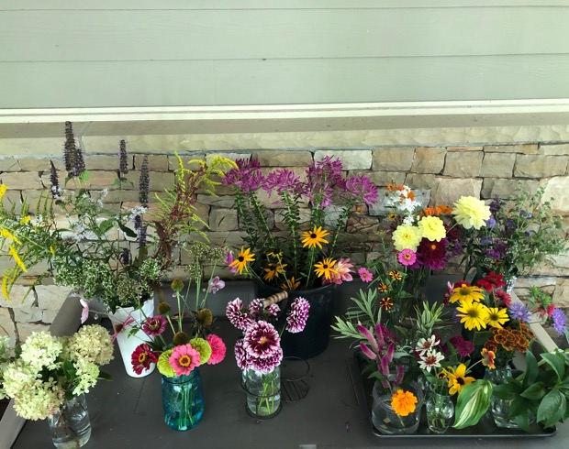
Step 1
Collect a variety of flowers, keeping stems long
Condition by giving stems a fresh cut and removing most leaves
Decide on a color pallet
Organize by height, foliage, type

Slide 3
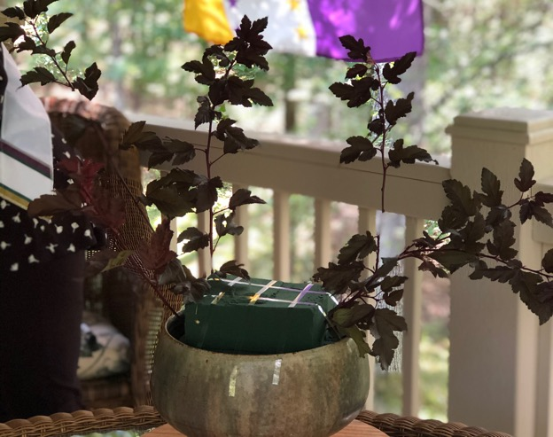
Step 2
Cut floral foam to fit container, allowing for extra height
Soak floral foam in water
Secure foam in container with floral tape
Add line flowers, 1 ½ - 2 times the height of the container
Ninebark

Slide 4
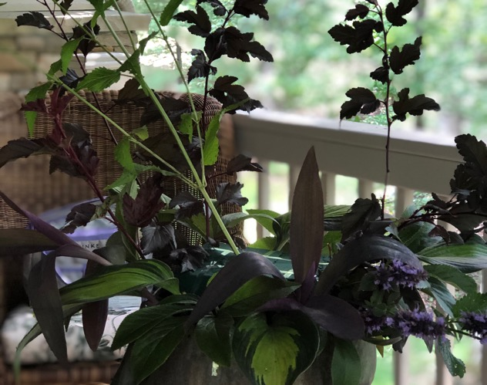
Step 3
Create the understory of your design by adding foliage around the rim of the container
Vary the colors
hosta leaves
house plants

Slide 5
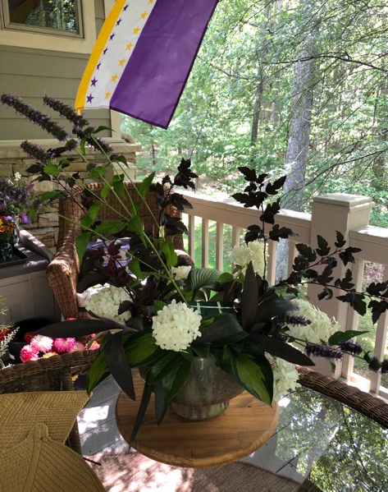
Step 4
Add larger flowers to the bottom part of the design
hydrangea

Slide 6
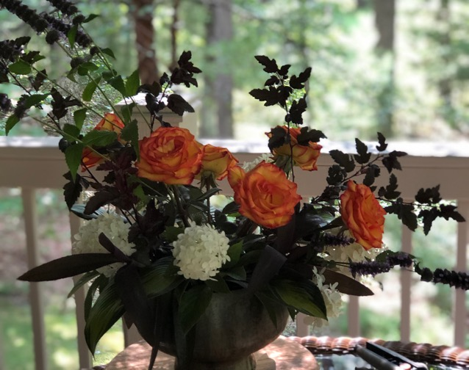
Step 5
Add your focal flower to the bottom half of the design, creating a rhythm
roses

Slide 7

Step 6
Add more line flowers with light and airy stems, vary texture
hyssop
larkspur
amaranthus

Slide 8
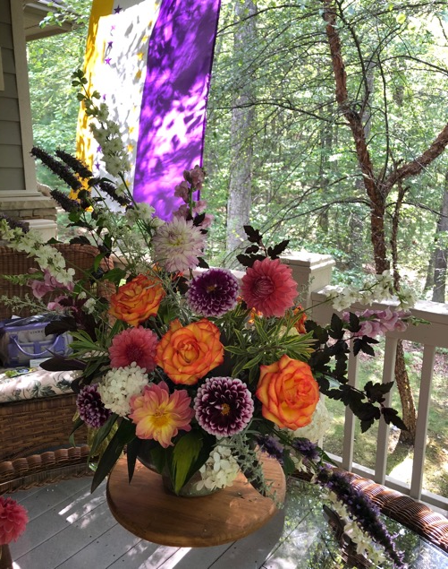
Step 7
Fill in with more flowers and texture
a variety of dahlias

Slide 9
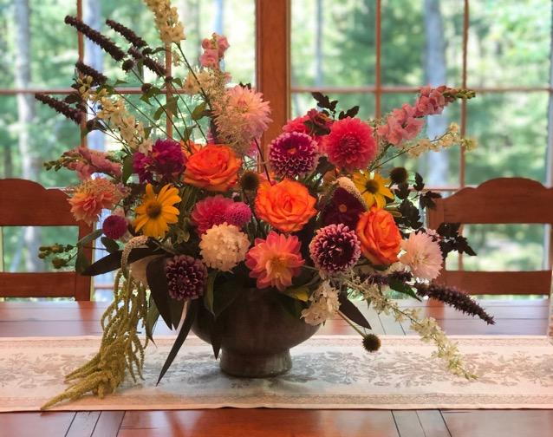
Final Arrangement
Traditional Victorian Mass design with a modern twist

